Slide 1




History
1899-1945: Founding of Vandemoortele
  Local manufacturer and supplier to soap and cattle feed industries becomes
  national producer of bulk edible oils
1946-1997: Vertical integration & diversification
  From national bulk edible oils producer to European vertically integrated oils & fats
  producer (crude oils, refined oils, bottled oils, margarine & fats, mayonnaises)
  Diversification into Bakery and Soy Foods
1998-2008: Focus on and expansion on of three activities
  Divestment of upstream activities (crushing and refining), of oil bottling and
  production of mayonnaises (except Belgian brands)
  Strong expansion of Lipids, Bakery and Soy Foods via organic growth and
  acquisitions, such as Panavi in 2008.
2009-present day: Focus on Lipids and Bakery Products
  Sale of Soy Foods division in 2009
  Acquisition of the margarines & fats business of Van Dijk Food Products in
  2010

Slide 2
Strategy
Vandemoortele focuses on two activities, in which we have a long tradition and where our customers are retailers as well as industrial and professional clients. These activities are:
  Bakery Products
  Lipids
With Bakery Products (689 m euros revenue) we are currently the biggest manufacturer in the growing European frozen bakery products market and we want to grow even further through organic growth and acquisitions.
With Lipids (584 m euros revenue) we also have a leading position in the European margarines & fats market and we want to strengthen this position further in Western Europe and expand it in Central Europe.

Slide 3
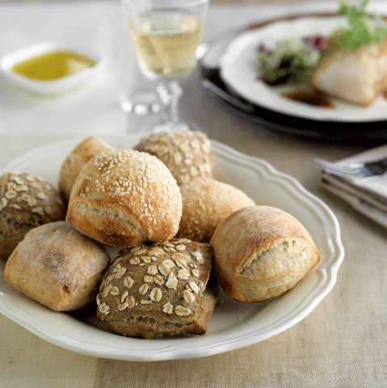
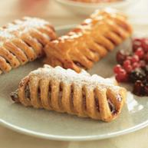
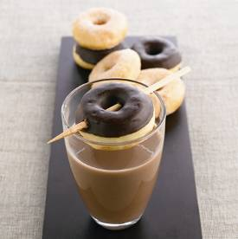
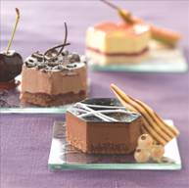
Bakery Products: product range
Bread
  Classic bread (baguettes, bread rolls,...) and a unique range of bread specialities, made according to a traditional recipe from the French Pyrenees
  Convenience level: ready to serve, ready to bake, ready to prove
  Brands: Les Pains Pérènes de Roland Cottes®, Banquet d’Or®, Panavi® and Croustifrance®
Pastry
  Products such as croissants, Canadian maple pecan and butter pastries developed with the experience and expertise of artisan bakers
  Convenience level: ready to serve, ready to bake and ready to prove
  Brands: Banquet d’Or®, Panavi® and Croustifrance®
American products
  Extensive range of products made according to an original American recipe with packaging concepts for all market segments: donuts, cookies, brownies, muffins and cakes
  Convenience level: ready to serve
  Brand: The Originals*®
Patisserie
  Patisserie range: bavarois, cakes in baking tin shapes, round cakes and tarts with rich fruit content and chocolate decorations
  Convenience level: ready to serve
  Brands: Banquet d’Or® and Pâtisserie du Chef®

